Slide 1
6. Compile and Run
Presented by S.R.Zameer

Slide 2
Compile and Run
In the Java programming language, all source code is first written in plain text files and save with the .java extension. After compilation, .class files are generated by javac compiler. A .class file does not contain code that is native to your processor; it instead contains byte codes (it is machine language of the Java Virtual Machine (JVM)).

Slide 3
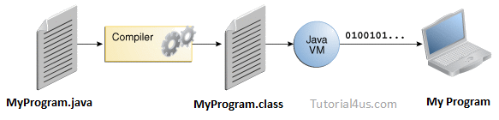
Contd…

Slide 4
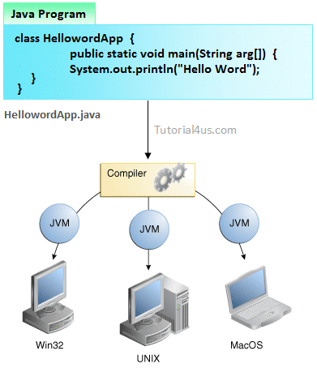
The java launcher tool then runs your application with an instance of the Java Virtual Machine (JVM).

Slide 5
Steps For compile Java Program
First Save Java program with same as class name with .java extension. Example:
Sum.java
Compile:
javac Filename.java
Example:
javac Sum.java

Slide 6
Steps For Run Java Program
For run java program use java tool.
Run by:
java Filename Example:
java sum

